Slide 1



Group14
Objection Detection
Team member:
张意恒 12311013 盛鹏 12112518 SREYNY 12113053 虞快 12111510
2024.12

Slide 2
1
Introduction to Our Work
2
Yolov5 model
3
SSD_MobileNet_V2 model
4
Resnet18 model
5
Implementation

Slide 3
1
Introduction to Our Work

Slide 4
Introduction
Selected Models:
YOLOv5: A fast and accurate object detection algorithm, ideal for real-time applications.
MobileNet-SSD-v2: A lightweight object detection model with 267 layers and 15M parameters, optimized for real-time inference on low-resource devices like smartphones.
ResNet18: A lightweight ResNet model with 18 layers and residual blocks, offering excellent feature extraction and classification while solving gradient vanishing issues in deep networks.
common features:
Can be used for object detection
Lightweight model
Good community support

Slide 5
Projects we implemented
Object Detection:
We referenced two projects on GitHub and successfully deployed them on the Jetson Nano
one is based on opencv, using yolov5 model.
another is based on jetson library using SSD_MobileNet_V2 model.
jetson introduction:
The jetson library is part of the Jetson-Inference project,
providing an easy-to-use API to implement the process of building TensrRT and using the engine for inference,
as well as providing common tools such as calling cameras and debugging on the jetson nano
amirhosseinh77/JetsonYolo: Simple process for camera installation, software and hardware setup, and object detection using Yolov5 and openCV on NVIDIA Jetson Nano.
dusty-nv/jetson-inference: Hello AI World guide to deploying deep-learning inference networks and deep vision primitives with TensorRT and NVIDIA Jetson.

Slide 6
Pose Detection:
it is based on jetson library and use Resnet18 model.
hand pose detection
body pose detection

Slide 7
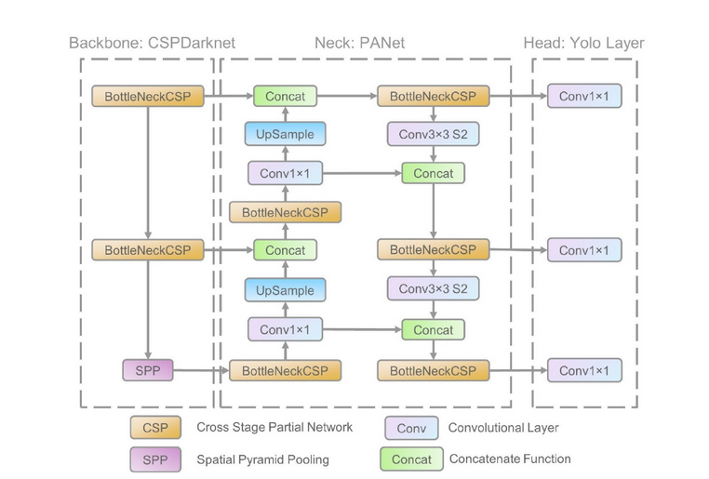
2
Yolov5 model
real-time object detection algorithm created by Joseph Redmon, Santosh Divvala, Ross Girshick, and Ali Farhadi in 2015
pre-trained on the COCO dataset. It uses a single neural network to process an entire image.
Architecture are composed of three components: Backbone, Neck and a Head to make dense predictions as shown in the figure below:
Figure 1. Network architecture for YOLO v5

Slide 8
YOLOv5 Overview: A real-time object detection model that identifies and locates objects in a single neural network pass.
Input Image Processing:
Resize and normalize the image (e.g., 640×640).
Split the image into a grid for object detection.
Backbone (Feature Extraction):
Uses a CNN to extract key features (edges, shapes, textures).
Reduces image size while increasing feature depth.
Neck (Feature Fusion):
Combines features using FPN and PAN for multi-scale detection.
Detects objects at different scales (small, medium, large).
Produces feature maps (e.g., 80×80, 40×40, 20×20).
Head (Prediction):
Applies anchor boxes to predict bounding boxes.
Outputs class labels, objectness scores, and bounding box coordinates.
Post-Processing:
Removes low-confidence predictions.
Applies Non-Maximum Suppression (NMS) to eliminate overlapping boxes.
Outputs final detections with class, confidence, and bounding box.

Slide 9
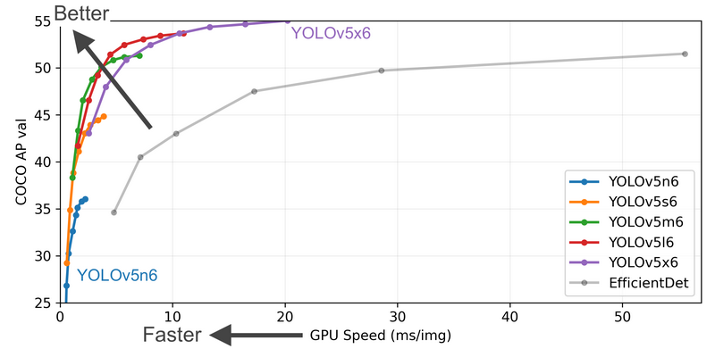
Performance
It is also good to mention that YOLOv5
was released with five different sizes:
n for extra small (nano) size model.
s for small size model.
m for medium size model.
l for large size model
x for extra large size model
Figure 2. perrformance of YOLOv5 different sizes models

Slide 10
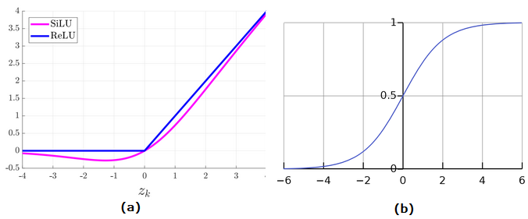
Activation Function
(a) SiLU function graph. (b) Sigmoid function graph.
SiLU (Sigmoid Linear Unit/Swish):
Used in the hidden layers with convolution operations.
A smooth activation function combining linear and non-linear properties.
Sigmoid:
Used in the output layer with convolution operations.
Outputs values between 0 and 1, ideal for probability-based predictions.
Figure 2. perrformance of YOLOv5 different sizes models

Slide 11
Loss Function
YOLOv5 Outputs:
Classes: Detected object categories.
Bounding Boxes: Predicted object locations.
Objectness Scores: Confidence that an object exists in a box.
Loss Functions:
Binary Cross Entropy (BCE): Computes class loss and objectness loss.
Complete Intersection over Union (CIoU): Computes location loss.
Final Loss Formula: Combines BCE and CIoU losses to calculate the total loss for optimization.

Slide 12
3
SSD_MobileNet_V2 model

Slide 13
Resnet18 model
4

Slide 14
Implementation
5

Slide 15
Object Detection

Slide 16
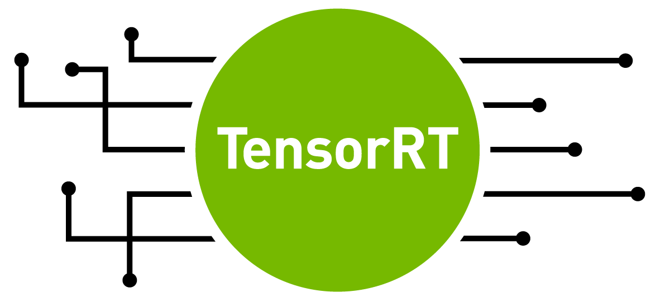
Enhancing Performance with TensorRT Acceleration
NVIDIA® TensorRT™ is an SDK that facilitates high-performance machine learning inference. It complements training frameworks such as TensorFlow, PyTorch, and MXNet. It focuses on running an already-trained network quickly and efficiently on NVIDIA hardware.
·SDK for efficient realization of the inference process ·Includes inference optimizers and runtime environment ·Enables DL models to run with higher throughput and lower latency ·Has C++ and Python APIs, which can be mixed and matched.
Developer Guide :: NVIDIA Deep Learning TensorRT Documentation

Slide 17
Comparison
In our tasks:
the task that do not use TensorRT have a PFS of around 10.
the task using TensorRT can achieve PFS of around 25.
You can see a visible difference in the Implementation

Slide 18
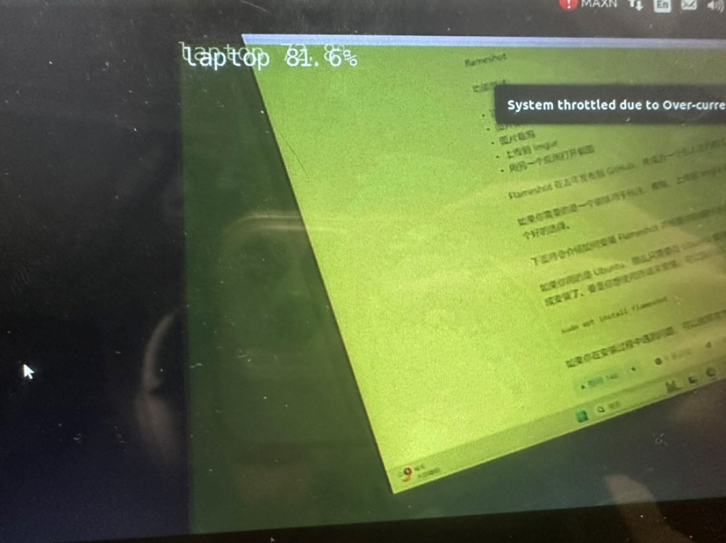
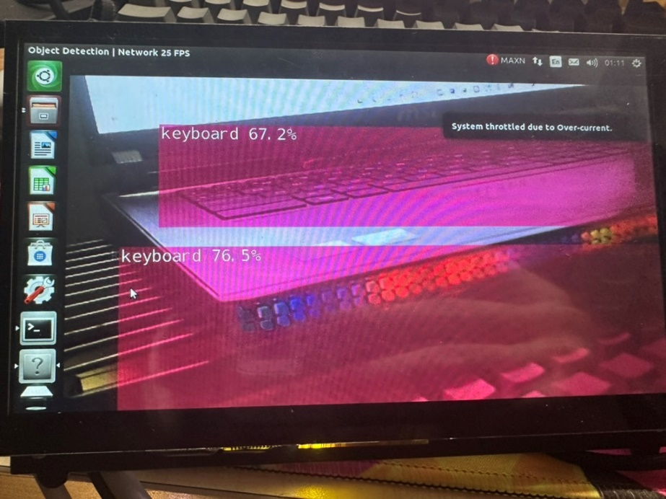
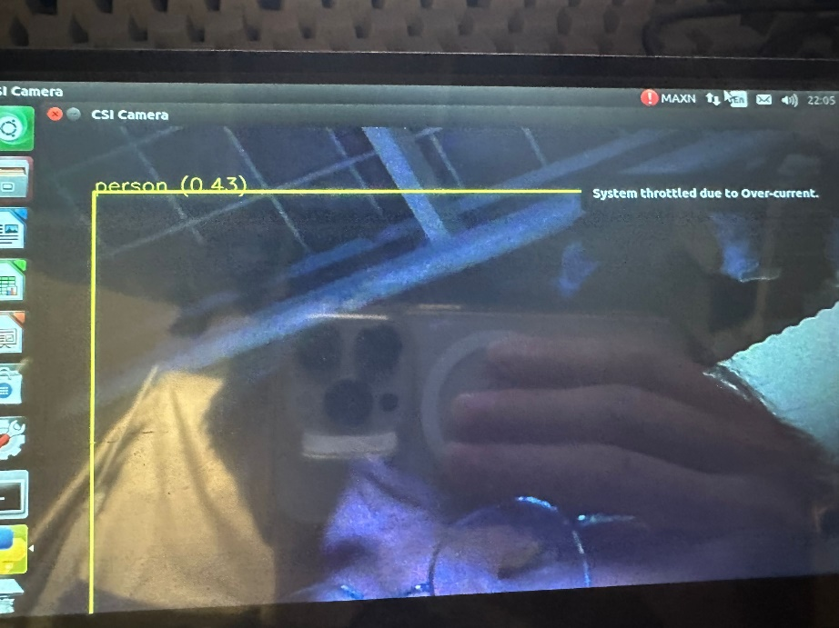
Correct identification

Slide 19
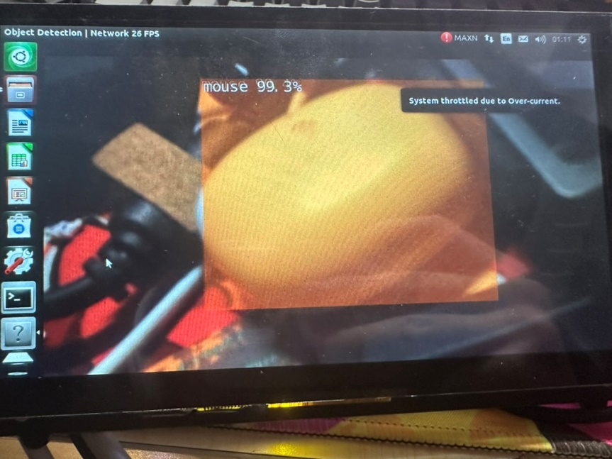
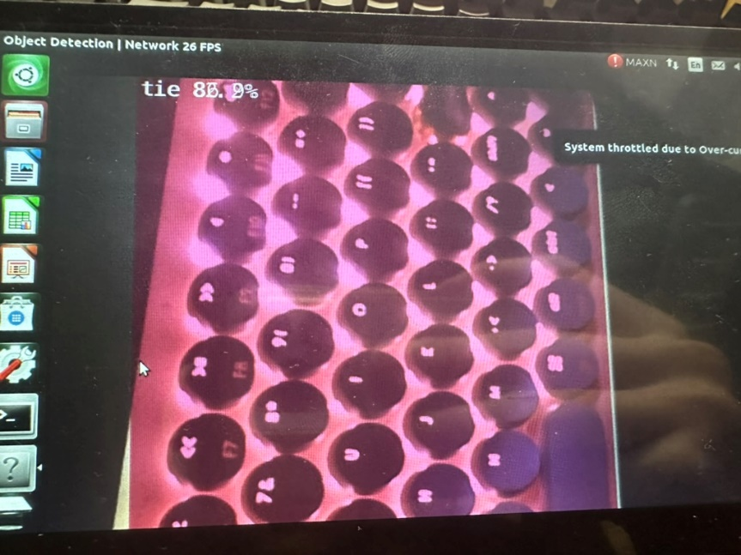
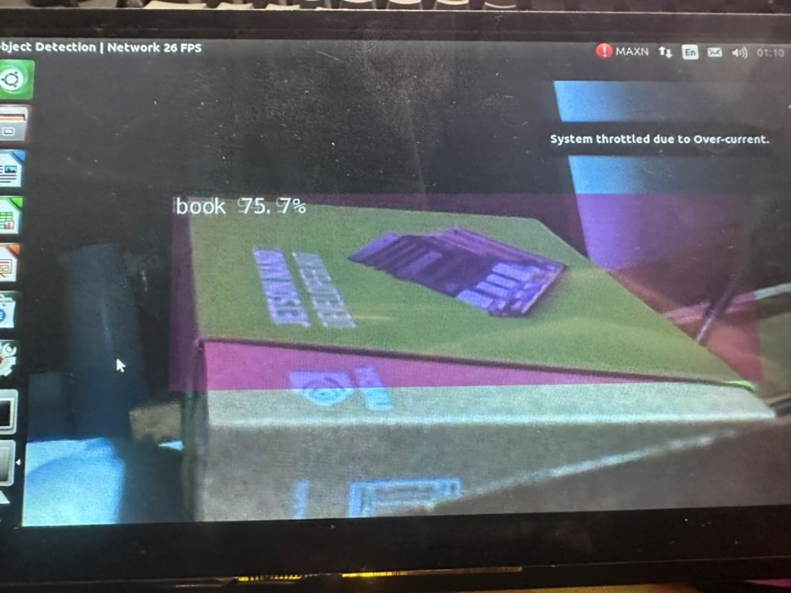
wrong identification

Slide 20
Pose Detection

Slide 21
Optimal Threshold Selection
in this task we can set a hypermeter called threshold.
A small threshold value reduces the requirements of the model and thus the accuracy. But if the threshold is too small, the error rate is too high and the value is unavailable
A large threshold value increases the requirements of the model and thus improves accuracy. But If the threshold is too large, the required objects cannot be detected
therefore we need to find the optimal threshold.

Slide 22
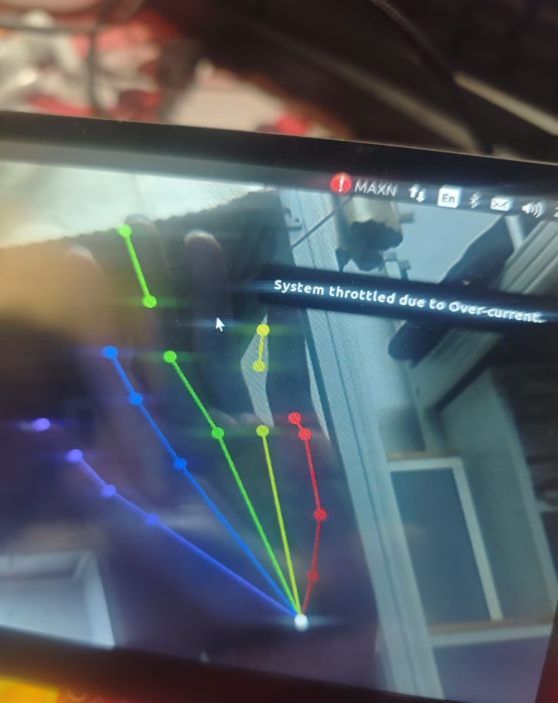
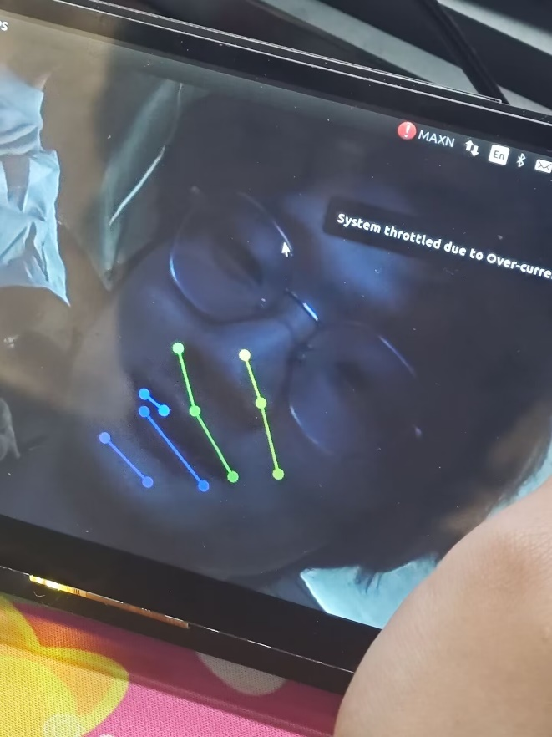
Implementation
In hand pos detect task, what we want is only hand will be detected.
If we use threshold = 0.1,both face and hand will be detected.

Slide 23
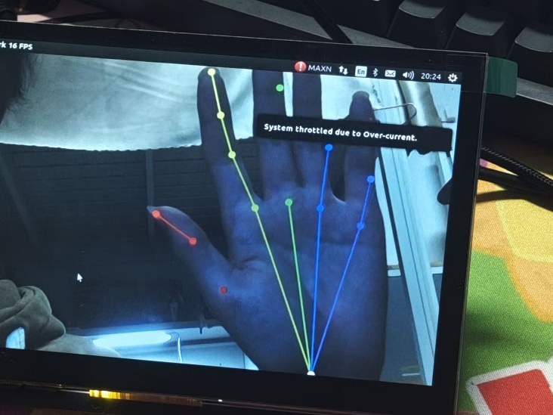
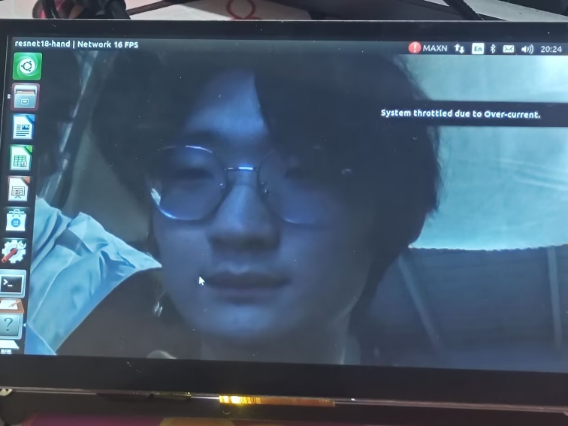
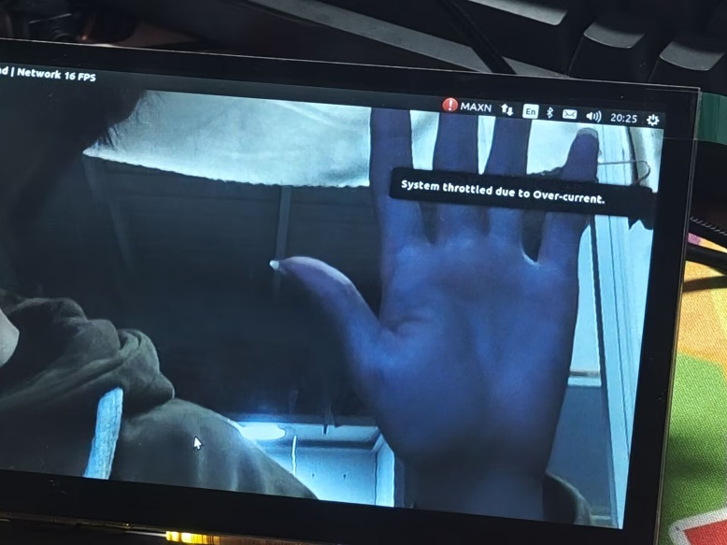
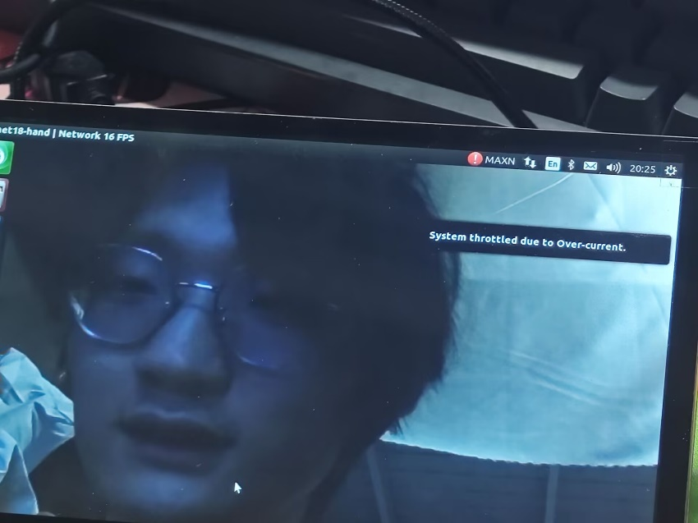
If we use threshold = 0.5,only hand will be detected.
If we use threshold = 0.9,both face and hand will be not detected.

Slide 24

Thanks for listening!
2024.12

Slide 25
Implementation
We referenced two projects on GitHub and successfully deployed them on the Jetson Nano
one is based on opencv, using yolov5 model.
another is based on jetson library using SSD_MobileNet_V2 model.
jetson introduction:
The jetson library is part of the Jetson-Inference project,
providing an easy-to-use API to implement the process of building TensrRT and using the engine for inference,
as well as providing common tools such as calling cameras and debugging on the jetson nano
amirhosseinh77/JetsonYolo: Simple process for camera installation,
software and hardware setup, and object detection using Yolov5 and openCV on NVIDIA Jetson Nano.
dusty-nv/jetson-inference: Hello AI World guide to deploying deep-learning inference networks
and deep vision primitives with TensorRT and NVIDIA Jetson.

Slide 26
Members and Roles

